Slide 1
Employee Data Analysis using Excel
STUDENT NAME : PAVAN K
REGISTER NO : 2201111036051
NM ID : 8DD51B1917AAE279BD849FCC1CDF2ED0
DEPARTMENT : B.COM (GENERAL) 3rd YEAR
COLLEGE : L. N GOVERNMENT COLLEGE PONNERI

Slide 2
PROJECT TITLE
Employee Performance Analysis using Excel

Slide 3


AGENDA
Problem Statement
Project Overview
End Users
Our Solution and Proposition
Dataset Description
Modelling Approach
Results and Discussion
Conclusion
3/21/2024 Annual Review

Slide 4

PROBLEM STATEMENT
Analyzing employee performance helps improve productivity by identifying strengths and areas for development. It aligns individual goals with organizational objectives, enhances motivation through feedback, and supports fair decisions on compensation and promotions. This process also aids in early issue detection and fosters a positive organizational culture.

Slide 5

PROJECT OVERVIEW
Employee performance analysis involves evaluating how well employees perform their job duties and contribute to organizational goals. It includes assessing various aspects such as productivity, quality of work, and behavior. This process helps identify strengths, areas for improvement, and development needs. It also supports decision-making related to promotions, compensation, and training. Ultimately, it aims to enhance both individual and organizational performance.

Slide 6

WHO ARE THE END USERS?
The end users of employee performance analysis include managers and supervisors for feedback and development, HR for training and compensation decisions, executives for strategic planning, employees for personal growth, and organizational stakeholders for assessing overall effectiveness.

Slide 7

OUR SOLUTION AND ITS VALUE PROPOSITION
CONDITIONAL FORMATING – MISSING IDENTIFY
FILTER - REMOVE
FORMULA - IFS(multiple condition)
PIVOT TABLE - SUMMARY
GRAPH - DATA VISUALISE
SLICER & OTHERS - INDIVIDUAL DATA

Slide 8
Dataset Description
EMPLOYEE DATA SET – KAGGLE
27 – FEAUTURES
BUT USED 11 FEAUTURES ONLY THEY ARE ;
employee id - number
first name - name
last name - name
business unit - category
employee status - types
employee type - category
employee classification type - category
gender code - male / female
performance score - levels
current employee ratings - number
performance level - very high/high/medium/low

Slide 9

THE "WOW" IN OUR SOLUTION
1.PERFORMANCE LEVEL=IFS(Z8>=5,”VERY HGH”,Z8>=4,”HIGH”,Z8>=3,”MED”,TRUE,”LOW”)
2. ELIMINATION OF MISSING VALUES
USING FILTER AND CONDITIONAL
FORMATTING
3/21/2024 Annual Review
9

Slide 10
MODELLING
DATA COLLECTION
1.EDUNET DASH BOARD DOWNLOAD
2.EXCEL OPEN
FEATURE COLLECTION
1.FORMULA
2.RATINGS VALUE
DATA CLEANING
1.MISSING VALUES
2.FILTERING
3.RATING TO LEVELS
10

Slide 11
MODELLING
PIVOT TABLE
RECOMMENDED CHART
SLICER
DIFFERENT CHARTS
TABLE VALUES
RECOMMENDED CHART
TRENDLINE
EXPONENDED TREND LINE
OFF BLANK VALUES
ENABLING CHART TITLE
ENABLLE CHART VALUE

Slide 12
MODELLING
SLICER
INDIVIDUAL ANALYSIS
USING FEATURES OPTION TO WATCH
TABLE
USING GENDER CODE FOR FILTER
WATCH OUT BUSINESS UNIT
BASIS ON LEVEL

Slide 13
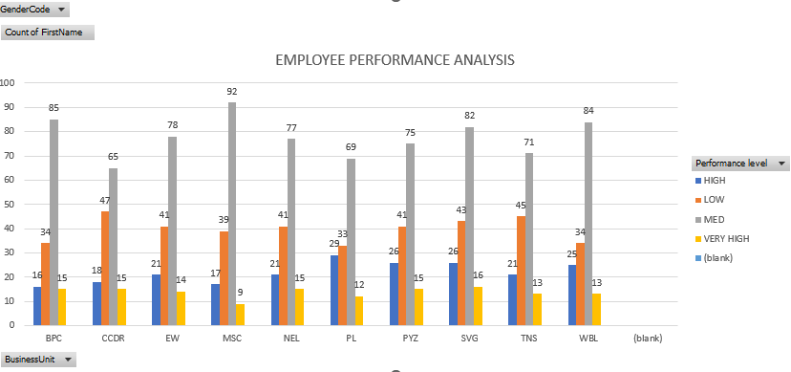
RESULTS OVERALL
13

Slide 14
EXPLANATION ;
Overall employee performance offers numerous benefits that significantly enhance organizational success. When employees perform well, productivity increases, driving the company towards its goals more efficiently. High-performing individuals also deliver superior quality work with fewer errors, contributing to better overall output. Their innovation and creativity can lead to fresh ideas and solutions that propel the business forward. Moreover, strong performance boosts team morale and motivation, fostering a positive work environment. Excellent employees also improve customer service, leading to higher satisfaction and loyalty.

Slide 15
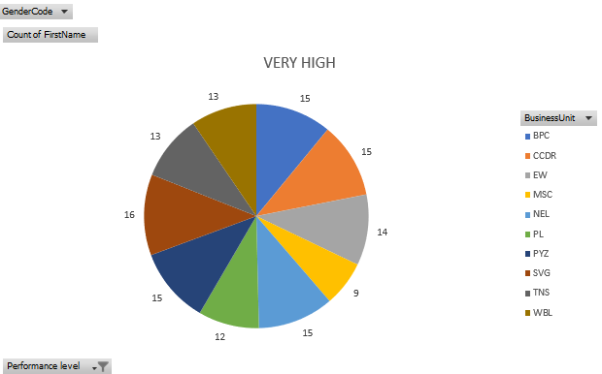
RESULTS VERY HIGH
15

Slide 16
EXPLANATION ;
Very high employee performance can be analyzed through several key metrics. Firstly, productivity rates can be measured, highlighting how efficiently the employee meets or exceeds targets. Quality of work is another critical factor, reflecting the precision and excellence in their output. Innovation and problem-solving skills can be assessed through the introduction of new ideas and effective solutions. Employee engagement and morale are also important, as top performers often exhibit high levels of motivation and commitment. Additionally, their impact on customer satisfaction and retention provides insight into their contribution to the company's reputation. Finally, analyzing cost savings related to their work can reveal the financial benefits of their exceptional performance.

Slide 17
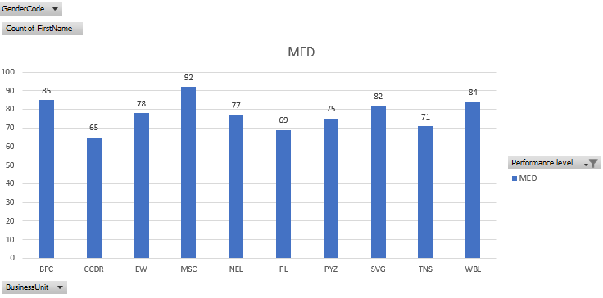
RESULT MEDIUM

Slide 18
EXPLANATION ;
Analyzing medium employee performance involves examining several key factors. Productivity can be assessed to determine if the employee meets average performance standards and contributes adequately to team goals. The quality of their work should be reviewed to identify any recurring issues or areas needing improvement. Innovation and problem-solving capabilities are evaluated to gauge their contribution to process improvements. Employee engagement levels can be analyzed to understand their motivation and commitment. Customer feedback and satisfaction scores provide insights into how their performance impacts client relationships. Finally, cost-effectiveness can be reviewed to ensure that their output justifies the investment in their role.

Slide 19
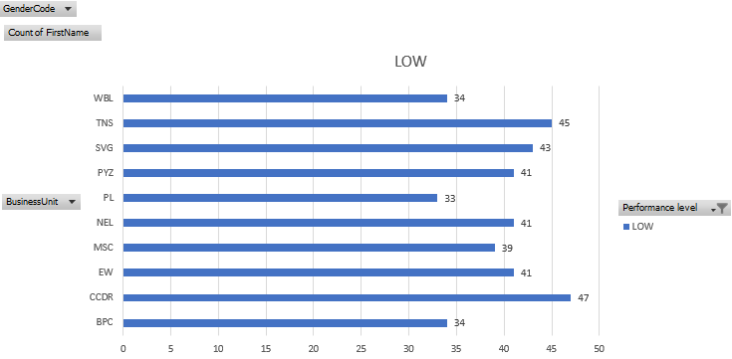
RESULT LOW

Slide 20
EXPLANATION ;
Analyzing low employee performance involves assessing several critical aspects to pinpoint underlying issues. Productivity levels should be measured to determine if the employee fails to meet established goals or benchmarks. The quality of their work must be reviewed for frequent errors or substandard results. Innovation and problem-solving abilities should be evaluated to see if they lack initiative or creativity. Employee engagement is crucial; low performance often correlates with decreased motivation or dissatisfaction. Customer feedback may reveal negative impacts on service quality or client relations. Finally, a cost-effectiveness analysis can show whether the employee's performance results in inefficiencies or increased expenses relative to their output.

Slide 21
conclusion
a comprehensive employee performance analysis is vital for understanding and enhancing individual and organizational effectiveness. By examining productivity, quality of work, innovation, engagement, and impact on customer satisfaction, organizations can identify strengths and areas for improvement. Addressing these factors ensures that employees are aligned with organizational goals and are contributing positively to the overall success. Moreover, a nuanced analysis helps in tailoring support and development opportunities, ultimately fostering a more motivated and high-performing workforce. Continuous performance evaluation not only drives individual growth but also enhances collective performance, ensuring sustained organizational success.

